Slide 1
Review of O.S. basics
Lecture 1

Slide 2
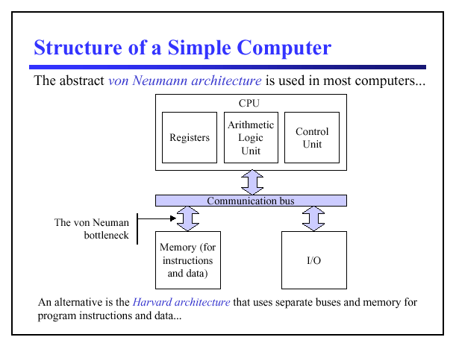

Slide 3
von Neumann Architecture (1945)
John Von Neumann is usually considered to be the developer of modern computer architecture.
The major guidelines that define a Von Neumann architecture are:
Stored program concept - memory holds both programs and data.
Memory is addressed linearly – i.e address consists of a single number
Memory is addressed without regard to content (instruction or data)

Slide 4
Von Neumann Architecture (1945)
Instructions are executed sequentially unless an instruction or an outside event cause a branch to occur.

Slide 5
Von Neumann Architecture
Von Neumann defined the functional organisation of the computer to be made up of:
A control unit that executes instructions
An arithmetic logic unit that performs arithmetic and logical calculations,
Memory locations
Input/output
Communication bus

Slide 6
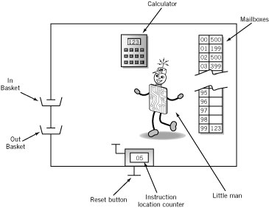
An illustration of von Newman computer

Slide 7
Contents of Memory locations
Op code
Operation code
Arbitrary mnemonic
Operand
Object to be manipulated
Data or
Address of data
Address | Content
 | Op code | Operand

Slide 8
Instruction Cycle
Fetch: Little Man finds out what instruction he is to execute
Execute: Little Man performs the work.

Slide 9
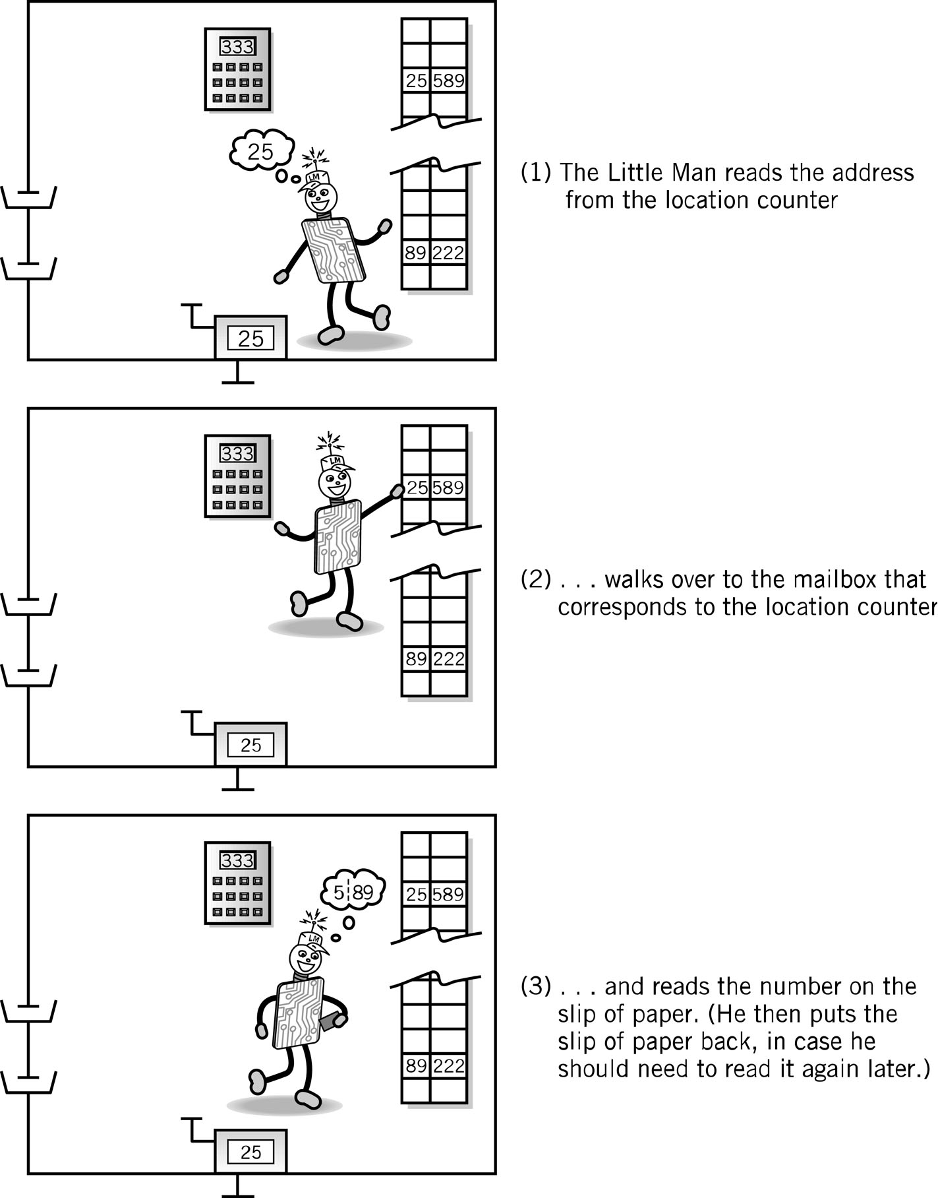
Fetch Portion of Fetch and Execute Cycle
1. Little Man reads the address from the location counter
2. He walks over to the mailbox that corresponds to the location counter

Slide 10
Fetch, cont.
3. And reads the number on the slip of paper (he puts the slip back in case he needs to read it again later)

Slide 11
Execute Portion
The execution portion of each instruction is, of course, different for each instruction.
However, even here, there are many similarities.
The load instruction (LDA) is typical.

Slide 12
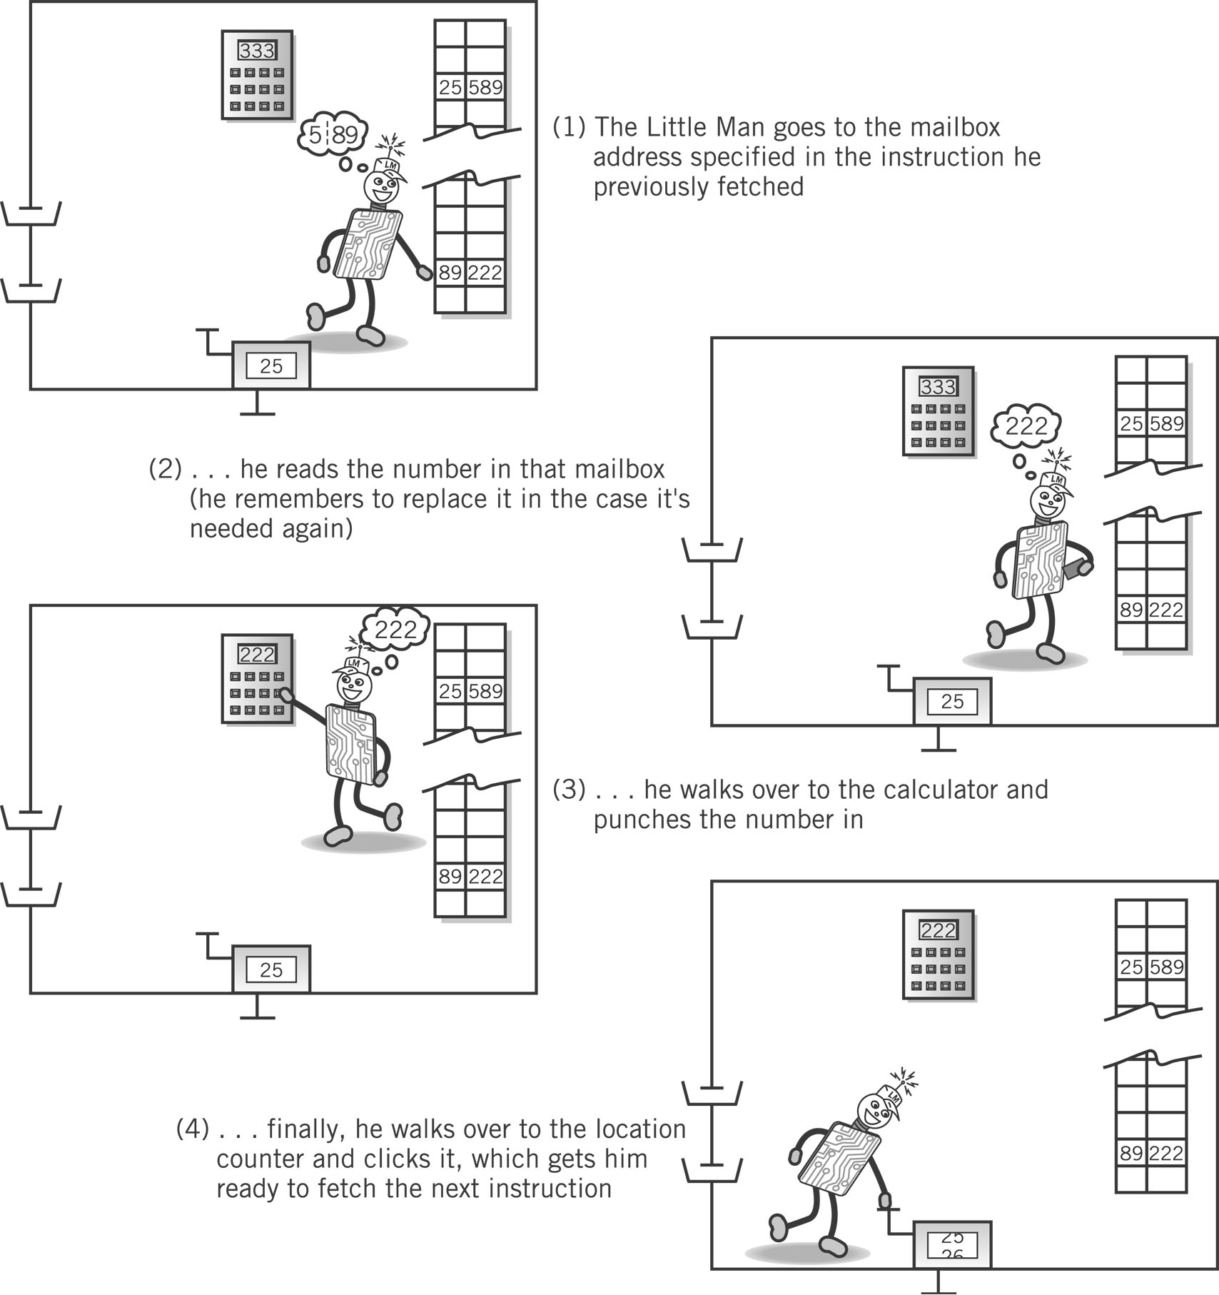
Execute Portion (LDA)
1. The Little Man goes to the mailbox address specified in the instruction he just fetched.
2. He reads the number in that mailbox (he remembers to replace it in case he needs it later).

Slide 13
Execute, cont.
3. He walks over to the calculator and punches the number in.
4. He walks over to the location counter and clicks it, which gets him ready to fetch the next instruction.

Slide 14
An O.S. Architecture
Application Programs
Shell Editors
Kernel
Assembler, loader
Compiler
Hardware

Slide 15
An O.S. Architecture
The hardware is encapsulated by the kernel
It provides systems services to application programs
The user communicates with the kernel via the shell
The user can invoke the C compiler to create applications which can be executed by the kernel

Slide 16
The UNIX O.S. Architecture
User Programs
User Level
Libraries
System Call Interface
Kernel Level
File Subsystem
Inter-process
Communication
Process
Control
Subsystem
Scheduler
Buffer Cache
Memory
Management
Character
Block
Device Drivers
Kernel Level
Hardware Control
H.W Level
Hardware

Slide 17
What is an Operating System?
Computer System
Software (programs)
Hardware (physical machine and electronic components)
Operating System
Part of computer system (software)
Manages all hardware and software
Controls every file, device, section of main memory and nanosecond of processing time
Controls who can use the system
Controls how system is used

Slide 18
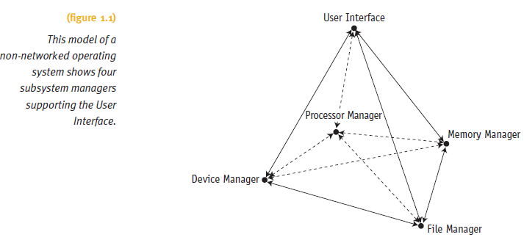
Operating System Software
Includes four essential subsystem managers
Main Memory Manager, Processor Manager
Device Manager and File Manager (hard drives)

Slide 19
Operating System Software (cont'd.)
Each manager:
Works closely with other managers
Performs a unique role
Manager tasks
Monitor its resources continuously
Enforce policies determining:
Who gets what, when, and how much
Allocate the resource (when appropriate)
Deallocate the resource (when appropriate)

Slide 20
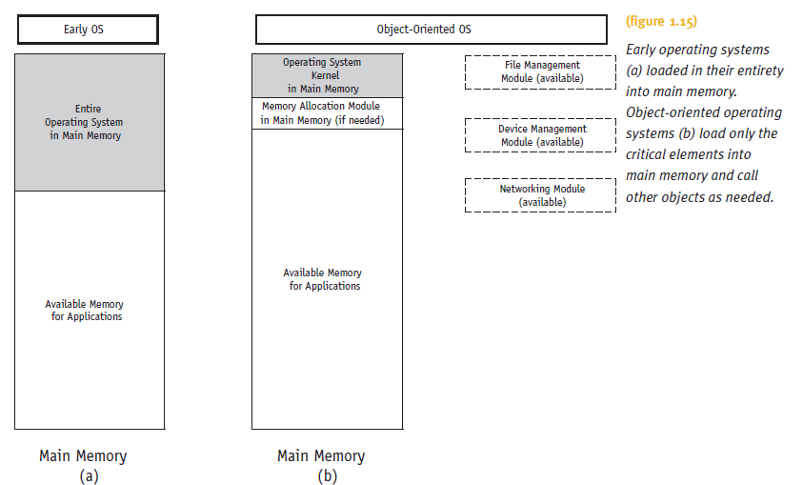
Object-Oriented Design (cont'd.)

Slide 21
Design Considerations
Most common overall goal
Maximize use of the system’s resources to maximise throughput (memory, processing, devices, and files) and minimize downtime
Factors included in developmental efforts
RAM resources
CPUs: number and type available
Peripheral devices: variety likely to be connected
Networking capability
Security requirements, etc.

Slide 22
Memory Manager
In charge of main memory
Random Access Memory (RAM)
Responsibilities include:
Preserving space in main memory occupied by operating system
Checking validity and legality of memory space request (can not use memory used by others programs)
Setting up memory tracking table
To keep track of who is using which section of memory
De-allocating memory to reclaim it

Slide 23
Old types of memory allocation
Two main types:
Fixed partition system
Dynamic partitions system
The main limitations of these basic memory allocation mechanisms are:
The program must be contiguous.
internal and external fragmentation (fragmentation refer to main memory space that can be utilised due to the nature of partitions)

Slide 24
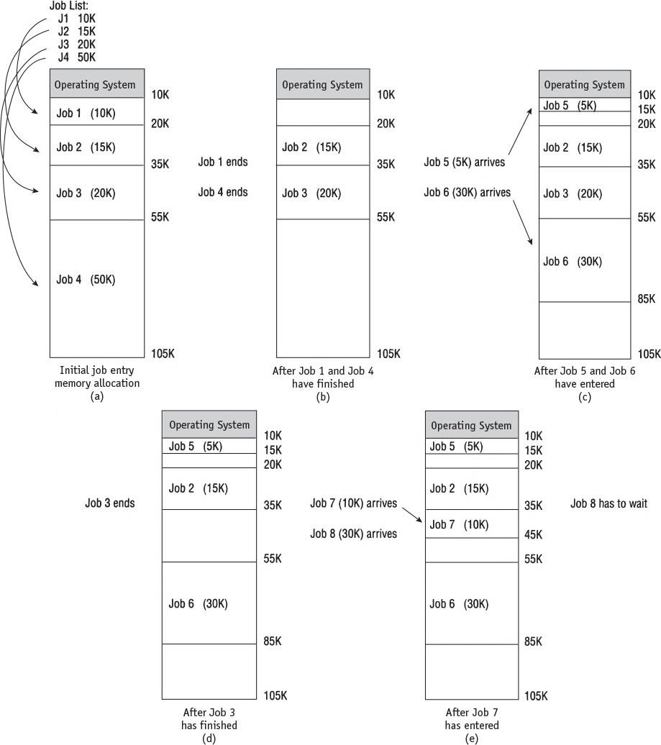
Dynamic memory
Main memory use during dynamic partition allocation. Five snapshots (a-e) of main memory as eight jobs are submitted for processing and allocated space
Job 8 has to wait (e) even though there’s enough free memory between partitions to accommodate it.
External fragmentation (unused memory between blocks)
24

Slide 25
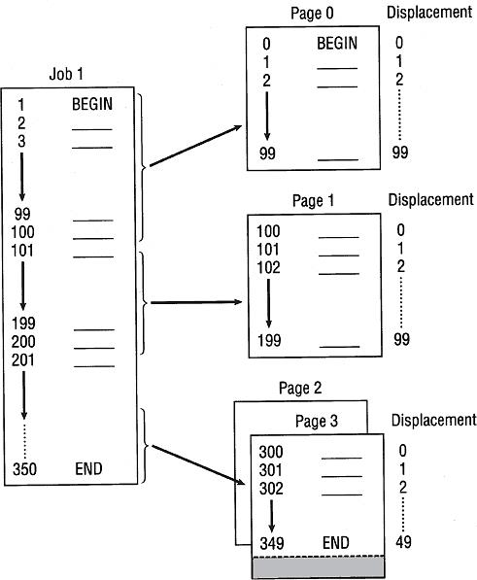
(figure 3.2)
This job is 350 bytes long and is divided into four pages of 100 bytes.
Each that are loaded into four page frames in memory.
The values 1..350 are referred to as the logical address (the way the CPU interoperates a program)

Slide 26
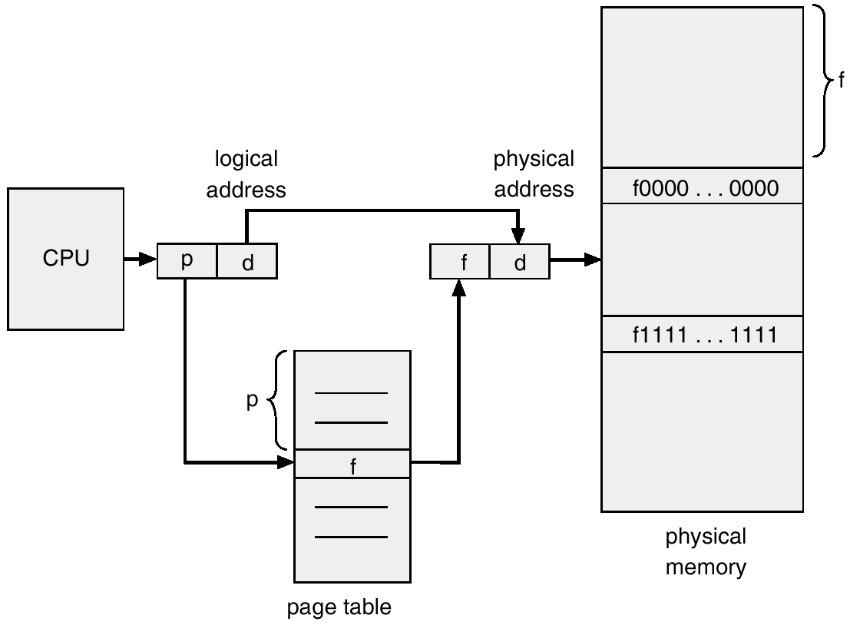
Logical (virtual) v physical address

Slide 27
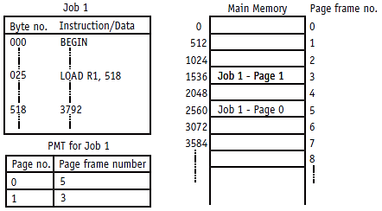
(figure 3.3): This system has page frame and page sizes of 512 bytes each. The PMT shows where the job’s two pages are loaded into available page frames in main memory: the logical address is that in the job. E.g. 518; the physical address is the actual location of this instruction.. In the above example frame 3 position 1536+6 = 1542

Slide 28
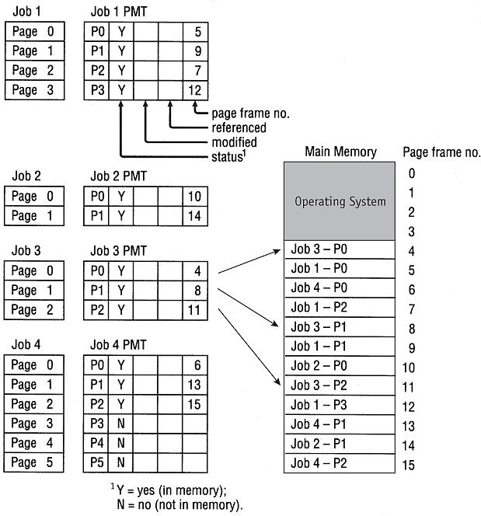
(figure 3.5)
Demand paging swapping requires that the Page Map Table for each job keep track of each page as it is loaded or removed from main memory. Each
PMT tracks:
the status of the page
whether it has been modified,
whether it has been recently referenced,
the page frame number for each page currently in main memory.

Slide 29
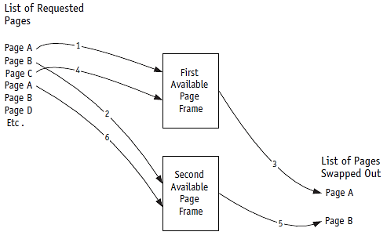
(figure 3.7)
First, Pages A and B are loaded into the two available page frames. When Page C is needed, the first page frame is emptied so C can be placed there. Then Page B is swapped out so Page A can be loaded there. © Cengage Learning 2014

Slide 30
The Mechanics of Paging (cont'd.)
Page Map Table: bit meaning
Status bit: page currently in memory
Referenced bit: page referenced recently
Determines page to swap: LRU algorithm
Modified bit: page contents altered
Determines if page must be rewritten to secondary storage when swapped out
Bits checked when swapping
FIFO: modified and status bits
LRU: all bits (status, modified, and reference bits)

Slide 31
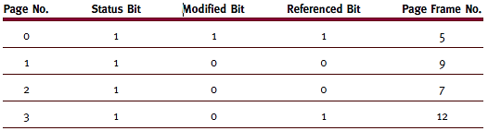
The Mechanics of Paging
Page swapping
Memory manage requires specific information: Page Map Table
(table 3.3)
Page Map Table for Job 1 shown in Figure 3.5.
A 1 = Yes and 0 = No. © Cengage Learning 2014

Slide 32
Clock policy-scanning for a page to remove
Before
After
This page remove
Unused pages
Used pages

Slide 33
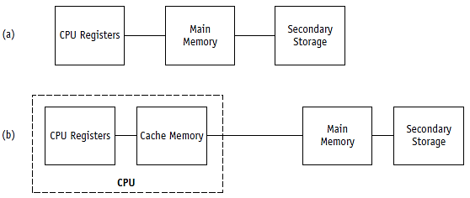
CPU registers: speed up lookup process by storing PMT/SMT of recently entries for active jobs
(figure 3.19)
Comparison of (a) the traditional path used by early computers between main memory and the CPU and (b) the path used by modern computers to connect the main memory and the CPU via cache memory. © Cengage Learning 2014

Slide 34
Definitions
Processor (CPU)
Performs calculations and executes programs
Program (job)
Inactive unit, e.g., “an application stored on a secondary storage disk”
Unit of work submitted by the user
Process (task)
A single instance of an executable program
Active entity that Requires resources (such as processor, special registers, its own memory space, and context data or process control box (PCB) ) to perform its function

Slide 35
Definitions (cont’d.)
Thread (of control)
Portion of a process; a process can have multiple threads of control
A process is equivalent to a program while threads are equivalent to modules/methods within the program
A thread is executed “independently” within the parent process;
Examples of multithreading:
Multiple queries to a database (a separate thread for each query);
Multiple connections TCP connections: a separate thread to deal with each connection.
An application that has a processing element and an i/o element where one thread processing and one thread to deal with the I/O
A word processor will have many threads; one for inputting data, one for backup or archiving the word document…

Slide 36
Process Scheduler (cont'd.)
Exploits common computer program traits
Programs alternate between two cycles
CPU
I/O cycles
General tendencies
I/O-bound job
Many brief CPU cycles and long I/O cycles (printing documents)
CPU-bound job
Many long CPU cycles and shorter I/O cycles ( a complex maths calculation)

Slide 37
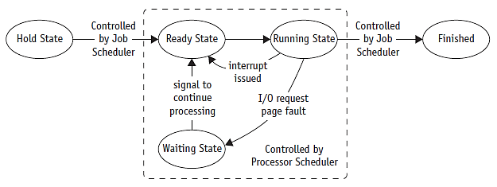
Job and Process States (cont'd.)
(figure 4.2)
A typical job (or process) changes status as it moves through the system from HOLD to FINISHED. © Cengage Learning 2014

Slide 38
A process control block
Process id. A unique number assigned when job enters the system
Process status: hold, ready, running waiting
Process state (all information to indicate current state of the job
Status: current instruction counter
register contents; e.g. accumulator register
Main memory: where the job is stored or PMT
Resources: hardware (disk) or files
Priority: determines when the job will run
Accounting: what resources the job used and for how long

Slide 39
Process Management
The entire state of the process at any instant is contained in its context (process control block)
Notes:
Figure 2.8 indicates a way in which processes may be managed. Two processes,
A and B, exist in portions of main memory. That is, a block of memory is
allocated to each process that contains the program, data, and context information.
Each process is recorded in a process list built and maintained by the OS. The
process list contains one entry for each process, which includes a pointer to the
location of the block of memory that contains the process. The entry may also
include part or all of the execution context of the process. The remainder of the
execution context is stored elsewhere, perhaps with the process itself (as indicated
in Figure 2.8 ) or frequently in a separate region of memory. The process index
register contains the index into the process list of the process currently controlling
the processor. The program counter points to the next instruction in that process
to be executed. The base and limit registers define the region in memory occupied
by the process: The base register is the starting address of the region of memory
and the limit is the size of the region (in bytes or words). The program counter and
all data references are interpreted relative to the base register and must not exceed
the value in the limit register. This prevents interprocess interference.
In Figure 2.8 , the process index register indicates that process B is executing.
Process A was previously executing but has been temporarily interrupted. The
contents of all the registers at the moment of A’s interruption were recorded in its
execution context. Later, the OS can perform a process switch and resume execution
of process A. The process switch consists of storing the context of B and restoring
the context of A. When the program counter is loaded with a value pointing into A’s
program area, process A will automatically resume execution.

Slide 40
Scheduling Policies
Multiprogramming environment
More jobs than resources at any given time
Operating system pre-scheduling task
Resolve three system limitations
Finite number of resources (disk drives, printers, tape drives)
Some resources cannot be shared once allocated (printers)
Some resources require operator intervention before reassigning: mouse click / keyboard…

Slide 41
Scheduling Policies (cont'd.)
Good process scheduling policy criteria
Maximize throughput
Run as many jobs as possible in given amount of time
Minimize response time
Quickly turn around for interactive requests
Minimize turnaround time
Move entire job in and out of system quickly
Minimize waiting time
Move job out of READY queue quickly: limit the number of users allowed on the system

Slide 42
Scheduling Policies (cont'd.)
Good process scheduling policy criteria (cont'd.)
Maximize CPU efficiency
Keep CPU busy 100 percent of time
Ensure fairness for all jobs
Give every job equal CPU and I/O time
Final policy criteria decision lies with system designer or administrator (select a scheduling policy that maximises efficiency of system resources)

Slide 43
Scheduling Policies (cont'd.)
Problem
Job claims CPU for very long time before I/O request issued
Builds up READY queue and empties I/O queues
Creates unacceptable system imbalance
Corrective measure
Interrupt
Used by Process Scheduler upon predetermined expiration of time slice
Current job activity suspended
Reschedules job into READY queue

Slide 44
5 Round Robin
Preemptive
Used extensively in interactive systems
Based on predetermined time slice (time quantum)
Each job assigned time quantum
Time quantum size
Crucial to system performance
Varies from 100 ms to 1-2 seconds
CPU equally shared among all active processes
Not monopolized by one job

Slide 45
Round Robin (cont'd.)
Arrival Time | 0 | 1 | 2 | 3
Job | A | B | C | D
CUP cycle time | 8 | 4 | 9 | 5
Timeline for job sequence A, B, C, D using the preemptive round robin algorithm with time slices of 4 ms.
Jobs A = (0, 8 ms), B (1, 4 ms), C (2, 9 ms) D (3, 5ms) (in this example assuming no I/O requests). It also use a FIFO queue
What is the average turnaround time?
(20 + 7 +24 + 22)/4 = 18.25 (to calculate time finishing time – arrival time)

Slide 46
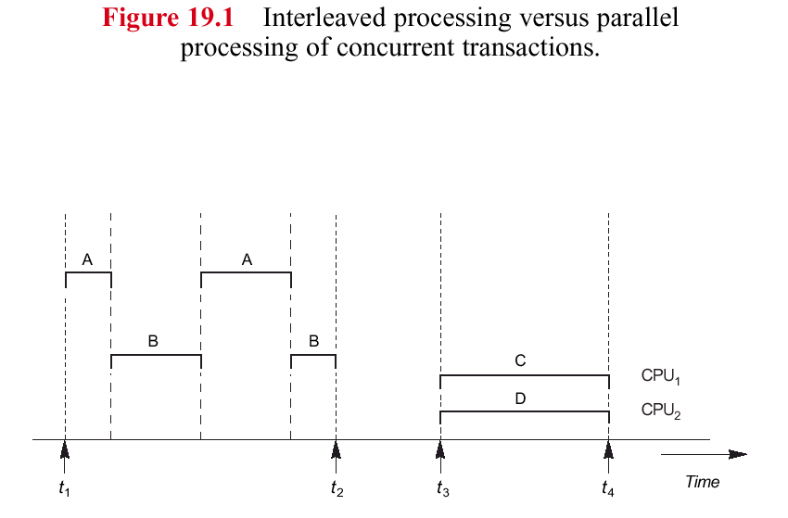
concurrency processing
Parallel processing

Slide 47
Why Concurrency Control?
Concurrency control is used to ensure the non interference or isolation property of concurrently executing transactions/processes. This is achieved by protocols that employ locking, in which transactions/ process get exclusive access to a data item,
However, the main limitation of controlling concurrency is deadlock and starvation which were covered in the last lecture

Slide 48
Process Synchronization Software (cont'd.)
Critical region
Part of a program that must be executed in “one action”. (All or Nothing)
Other processes must wait before accessing critical region resources
Processes within the critical region
Cannot be interleaved otherwise
Threatens integrity of operation (no all or nothing action)
48

Slide 49
Non Synchronisation example
if two processes or threads/transactions try to update the same object: Race/lost update problem
If fetch, modify, write sequence is unsafe:
Consider v = v + 1:
Thread A fetches v = 5 into a processor register within processor A
Thread B fetches v = 5 into a processor register within processor B
Thread B increments value in its processor register to 6
Thread B stores 6 into v
Thread A increments value in its processor register to 6
Thread A stores 6 into v

Slide 50
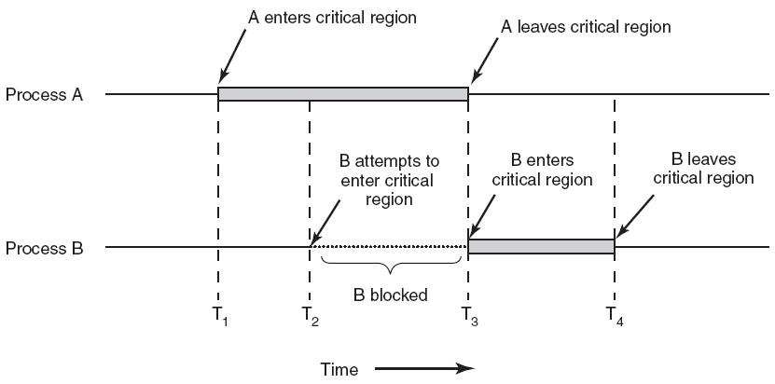
Critical regions of concurrent processes

Slide 51
Critical region (race problem)
In the previous example:
Step 1 occurs (fetch by process A)
Step 2 -4 must be blocked (fetch… update by B)
Step 5 and step 6 proceed. (update by process A)
Then steps 2-4 can proceed.
This ensures that the integrity of critical region (e.g. updating a register, that can not be interleaved) is maintained.

Slide 52
Ensuring Process Synchronization
Synchronization
Implemented as lock-and-key arrangement:
Process determines key availability
Process obtains key
Uses it to lock access to critical region
Makes it unavailable to other processes
Problems with locking mechanisms
Locking results in mutual exclusion
This characteristic of process synchronisation, if not controlled, can lead to two problems of multiprocessing systems:
Deadlock
starvation

Slide 53
Potential Exam Questions
What are the two advantages of partition memory management protocols of demand page memory protocols (4 marks)
Explain, using a suitable example, how to implement a virtual memory management. (8 marks)
Describe, using a suitable example, the relationship between logical and physical memory. (4 marks)

